Slide 1
OPFOR & ACE
Lt Col Adam ‘Trader’ Chitwood
Commander
Randolph AFB, TX & Langley AFB, VA
Accelerating Tech, TTPs, and UTCs to realize ACE alongside ACC units

Slide 2
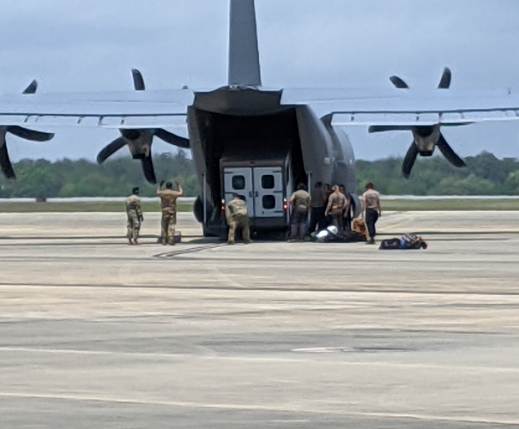
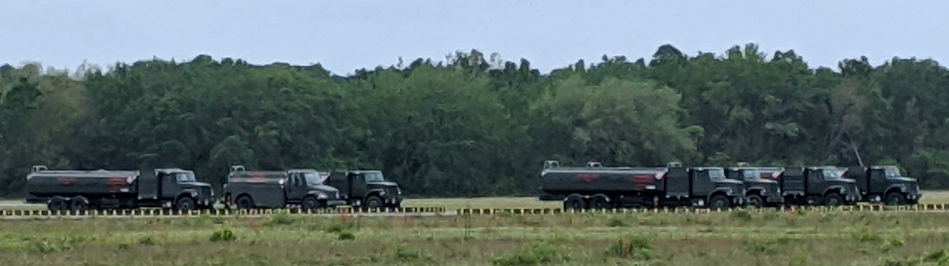
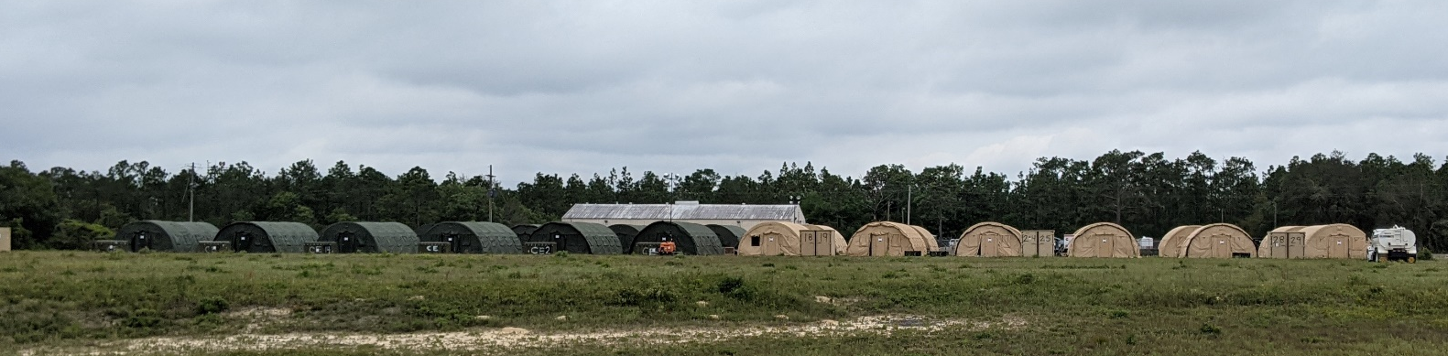
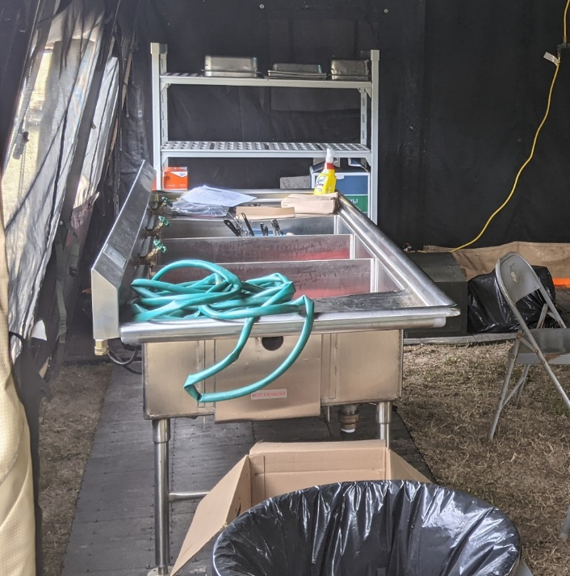
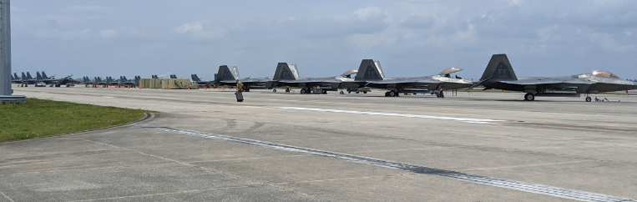
Agile Flag 21-2
Notes:
Upper left: 27 FS Bread Truck stuck in 9 AW C-130 during offload for CL FARP. Airmen, especially those at non-lead wing locations, don’t understand what ACE is, or their role in it. In this picture, the maintainers brought a bread truck to carry their tools, while others complained a C-130 was too small to support ACE. If Airmen aren’t taught what ACE is, they won’t come up with solutions to their piece of the pie. In this case, the bolt on units weren’t as agile as they could be because they brought too much stuff; stuff they were used to using at their home station.
Bottom left: Kitchen sink at FOB Choktaw. The METL for Agile Flag BOS-I functions required all the creature comforts Airmen are used to, including hot meals prepared on site. It took two weeks to setup the operating locations for a 2.5 day exercise. These timelines aren’t agile because our kit is too large. If we are going to maneuver within adversary targeting cycles or be small enough to not be detected, we have to reduce the amount of stuff we bring, even if it means being uncomfortable or taking risk in places we haven’t taken risk before.
Right hand pictures: Fuel trucks at FOB Choktaw, Tent city at FOB Choktaw, Flight line at MOB Tyndall. While we dispersed assets between operating locations, we didn’t disperse assets at each operating location. Asset clustering will still make the adversary F2T2EA cycle easy to execute and keep our losses high in a kinetic conflict. A small number of missiles with DPICM, HE, or cluster warheads should be able to take out the forces pictured on the right. Regarding asset dispersal: camouflage, deception, warhead effective radius, secondary explosions, use of treelines, operating away from the base, and using current structures to minimize visible footprints should inform operations when you don’t have/need assets on the flight line.
*Update: Units are beginning to add dispersal at individual locations into their exercises.

Slide 3

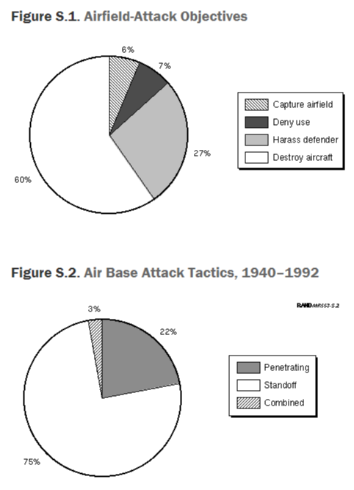
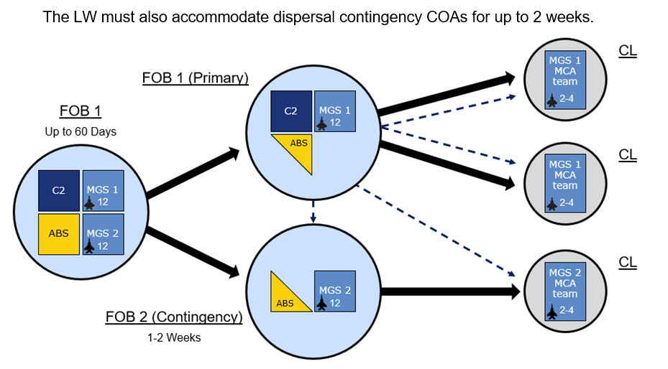
ACE in Combat (Dispersal Alone is Ineffective)
Historic Airfield Attacks (RAND study)
Weaknesses of ACE as Perceived by the PLA:
“Uncertain whether regional countries would permit USAF to use airfields”
“Will not reduce USAF reliance on permanent bases”
Deploy ISR & strike platforms to find & quickly strike defenseless ACE locations
Notes:
The adversary doubts the USAF ability to maneuver inside of its targeting cycle, and expects the majority of USAF operations to be tied to major bases (MOB/FOB/HUB/SPOKE) which is easy to strike with catastrophic effects. Dispersal is not maneuver; and to be successful, a USAF unit has to be able to maneuver inside of threat timelines. At the UNCLASS level, we expect the adversary to primarily target aircraft, equipment, and personnel. Attacks on the airfield itself should be expected, but it is easier to repair a direct hit on a runway than a direct hit on an aircraft. Support facilities on bases such as POL farms are more problematic. However, being able to proactively and reactively maneuver between operating locations, and even off of airfields will degrade adversary objectives and enable the USAF to generate combat power over a longer period of time, even if at a reduced mass than we are used to in AFCENT operations.

Slide 4
ACE Challenges (ABL Observations)
Force Protection:
Not postured to survive the missile threat
Movement & Maneuver (M&M):
Large force elements have not demonstrated ability to maneuver
Command & Control:
C2 decisions are more uncertain with attrition
Information:
We haven’t mitigated signatures to complicate adversary ISR-T
Sustainment:
M&M incurs a sustainment/fires bill, but ensures force survival
The fourth dimension:
12-hour ops aren’t representative of operating environment
Notes:
MET development for ACE isn’t focused on the threat, which is what drove the development of ACE. OT&E to execute ACE is based on competing priorities of those at the table, not exercise/war game results. This doesn’t mean individual contributions are compromised, only that we aren’t preparing units to execute and aren’t training commanders to make risk-informed decisions; both of which are required to realize ACE at an accelerated pace. The challenges listed on this slide would be more transparent (or disproven) if an aggressor were to able to challenge units in ACE exercises.

Slide 5


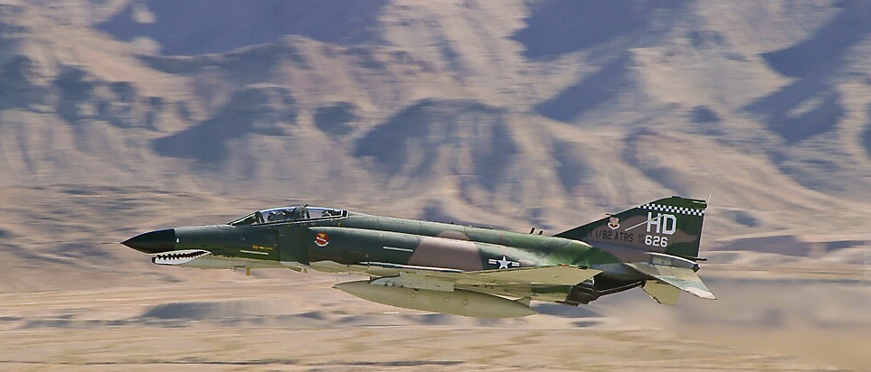
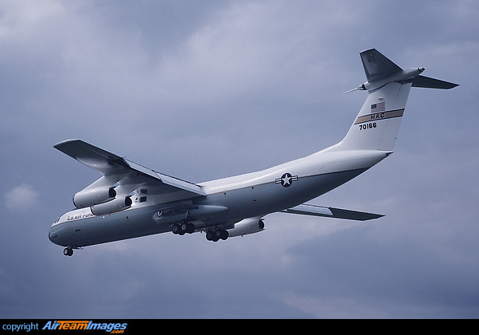
“What’s Past is Prologue”
“When they came to Red Flag for the first time, the B-52s entered the Nellis ranges at high altitude in a three-ship formation, trailing enormous white contrails for miles behind them. The Aggressors, who had a tally on these contrails from more than fifty miles away, shot all of them down. When the B-52 flight leader was asked why he did not change altitude when he knew he was producing contrails, he replied that he was flying at the altitude selected by his headquarters.”
“Therefore, the F-4 jocks took great pride in their ability to navigate exactly down the black line within a few seconds of their predicted time. They learned a different lesson at Red Flag. When an Aggressor jumped into the middle of their formation, and they took evasive action, black lines and timing within seconds went out the window. So did staying within a three-mile-wide low-level corridor. They not only had to plan on being forced off course at some time; they also had to learn how to reorient themselves and still get to the target.
“The C-141 was painted white, and the string formation they flew is what they always flew when they were delivering troops or cargo via parachutes to the ground. Of course, the Aggressors’ hot knives went through them like butter.”
Notes:
The failures identified by Aggressors in early Red Flag exercises were not a failure of any individual or organization. Instead the failures identified areas for the USAF to improve the way it OT&E’d. The B-52 & C-141 vignette occurred on their first participation in Red Flag. In a single event, their communities learned (or relearned) lessons which we now take for granted; but at the time those lessons had to be learned the hard way. Today, we need to learn lessons the hard way to focus on the right things in ACE. Agile Flag events should be places for units to train, fail, succeed, and be better prepared for combat. Executing an Agile Flag without Aggressors, inhibits the amount of learning at an exercise. We wouldn’t execute a Red Flag against white card injects weighed against bills which would make the event to difficult for Blue to succeed in. We shouldn’t execute an Agile Flag with that mentality either.

Slide 6
Building ACE OPFOR
Multi-Domain Adversary (V1)
Informed by Intelligence record
Intel boundaries/play areas/ROE to avoid CONUS collection concerns
Utilizes long range ISR
Space (EO/IR/SAR/EMS) or air-breathing assets
Utilizes cyber intelligence
Sets the ops tempo early in the event
Utilizes ballistic/cruise missiles, but can be surrogated by aircraft attack
Attempts to maintain offensive posture against Blue
Blue Tipping & Cueing to fight the adversary
Resourcing a Multi-Domain Adversary (V1)
COA 1: Wing versus Wing (Double the Training) (mixed-MDS will work)
COA 2: Crowd Source personnel/capes/units from USAFWC/Guard/etc
COA 3: Expand on a current contract (like contract Red Air)
Notes:
Aggressors of today are not the Aggressors of yester-year. We can build a “V1” Aggressor which improves upon white card injects with little or no additional monetary cost to ACC (what is the cost of heavy losses in conflict due to inadequate ACE training). The priority for a V1 adversary is an ISR-Targeting complex to execute long range fires. At the UNCLASS level, cyber and space / long range ISR is the highest priority and easiest to replicate. An informed adversary will also execute those long range strikes based on the intel community assessment of Red shot doctrine/kill chain/authority/etc. Blue forces should execute their mission to frustrate and strike OPFOR, just as in the western ranges of the NTTR.
The easiest COA for Aggressor creation would be to execute a Wing vs. Wing exercise; MDS similarity is not necessary as many wings are composed differently, presenting asymmetric options for success. Competition would drive innovation rapidly!
From the ABL’s perspective, crowd sourcing units from the Guard, current Aggressor units, and the intel community would more accurately replicate Red forces, but require additional collaboration and integration to build the OPFOR.
Contract support is possible; however, the ABL hasn’t seen any contractors which have Commercial-Off-The-Shelf Aggressor capability to replicate the current multi-domain adversary threat.

Slide 7
COA 2: Crowd Sourced OPFOR
BLUF: 1x intel flight (Red SMEs), 1x cyber aggressor flight, 1x Red Air 4-ship (71 FTS or 81 FS), & Commercial Space (current contracts)
60 Days to direct participation / gain unit concurrence
90 Days to build Scenario/TTPs/ROEs/TRs
Intel (Aggressors/Red Teams desired, but not required)
Execute intel analysis, targeting cycle, salvo tactics IAW Red Doctrine
Red Air assets
T-38 or A-29 could surrogate cruise missile attacks
Visual of getting strafed would leave a visceral memory
Traditional Red Air for DCA Mission is desired, but not required
ISR assets
Gov space assets difficult to task over CONUS & with short notice
May need commercial space to work around legacy policies
Big wing ISR or MQ-9 would surrogate Red ISR complex if available
Notes:
There isn’t a specific Aggressor unit to replicate PLA or Russian missile forces like the way the 64 AGRS replicates Red fighter execution. Finding an intel unit with the right Red ISR knowledge, or desire to learn in a short period of time should not be difficult. That unit could consist of a DOD Red Team, an Aggressor Squadron, or an Intel flight with motivated individuals. A 4-ship of missile surrogates would provide enough Red Air coverage to execute strikes directed by the Intel function. Missile surrogates could simply fly over airfields with specific targets at specific impact times, or execute strafing/dive bomb runs for a visual picture. Red Air wouldn’t necessarily pick targets of opportunity unless simulating manned aircraft like a J-11. Traditional Red Air escort of missiles are desired, but not required for a Version 1 Adversary. Sensor access of space and long range assets is slightly more difficult to resource over CONUS. Should bureaucratic processes inhibit access to sensors on short notice (Red wants to image a new airfield or larger area than just an airfield), utilizing current commercial space contracts will be easier to execute with lower levels of authority on reduced time lines. Cyber exploitation could present policy issues; however, the adversary is likely executing similar operations today without those policy hurdle, so any issues should be addressed a the highest levels to accelerate understanding of our unit weaknesses.
Once units are committed, development of a valid scenario, applicable tactics, training rules, and a Red plan is necessary. The timeline depicted still allows for 30 days of slip should policy issues such as intel personnel looking at CONUS imagery prove troublesome. Destruction of any non-military imagery capture post-exercise, combined with specific play areas (more than Blue will utilize) should provide for adequate risk mitigation on a trial basis for Agile Flag 22-2.

Slide 8
Preparation
As Red ups its game for Agile Flag, Blue will need to up its game
All players require intel briefs as part of spin-up cycle
ACC units require adequate education about the Operating Environment driving ACE: OG/MXG/MSG/MDG participants
Interviews & Chat Bot data reflects a lack of knowledge
Legacy metrics of performance still drive significant portion of ops
Blue units may need to take risk in some areas to increase preparation for Agile Flag
Multiple commanders have expressed a lack of time, resources, assets, support to prepare adequately for ACE
Training cycle focused on emerging TTPs & validated at Agile Flag
Notes:
Blue forces in general are not educated on the multi-domain threat they face (not just PL-12 vs AIM-120), which results in lagging ACE development. Education is required with enough time for exercise preparation, as opposed to academic briefs the day prior to exercise kick-off. This need is based off of observing multiple exercises, chat bot social data, and is touched on in Agile Flag 21-2 pictures. The Agile Battle Lab has seen an increasing demand signal for education on the operating environment and how to counter Adversary capabilities. Even in lead wings, comprehensive threat briefs and education are sparse; and sparser among traditional support functions which are critical to ACE execution.

Slide 9
Event Ops Tempo (M&M Incurs a Sustainment/Fires Bill)
Model event after Army National Training Center exercises
Periods of surge, maneuver, refit, surge (learning during lulls)
M&M would be covered by another synthetic wing during combat
Proposed Exercise Timeline
Similar to SAM Shoot-Look-Shoot tactic: Fight-Move-Fight
No pauses in exercise: Red can still attack egregious mistakes
Day 1: Fight your way into theater: no warm start
Day 2: 12 hour ops full war w/AOC (DCA & Strike)
Day 3: Maneuver & Refit: G-DCA & MAF Escort primary
Day 4: 24 hour war w/contested or absent AOC/HHQ
Day 5: Repel, survive, maneuver as required
Day 6: Final Debrief
Notes:
In a war in which the adversary may set the ops tempo, limiting exercises to contracted Blue vul periods establishes unrealistic expectations. An exercise which builds up, but is filled with surges and lulls enables ample repetitions, Blue & Red target looks, in-exercise learning/guidance, and command decisions based on a dynamic opponent. The intent isn’t to tire the unit, but to build an executable plan of action informed on current resourcing, evolving tactics, and combat impacts. Flying only AM & PM vuls ensures efficiency of operations, but ACE and peer-adversaries are inherently inefficient inputs. Chalks of personnel and equipment could potentially flow in to the exercise to simulate minimum & follow on forces in an actual execution of an OPLAN.

Slide 10
Debrief
Combat failures inform resource/training prioritization
OPFOR: Defend the motherland and punish blue mistakes
Why & how did Red kill Blue
Why & how did Blue frustrate or defeat Red
What can the unit improve? Don’t fly with contrails
What does the AF need to change? Don’t paint planes white
What requires better tactics? Don’t plan TOT within seconds
Outputs captured in 3-1, 3-4, Flash Tactics Bulletins, etc
Inform PEOs, POM prioritization, AFRL projects, etc
Notes:
Building a thinking adversary will enable ACC units to understand the impacts of their weaknesses. Current assessments and proposed improvements to survivability & lethality are informed hypotheses. Proving or disproving those hypotheses will inform prioritization for improvement at the unit, MAJCOM, Service, and Joint level.

